Slide 1


LINUX
LINUX

Slide 2

LINUX
LINUX
Translation; Vocabulary; Telecommunications; Understanding Three Steps of the Writing Process in Business Communication

Slide 3

INTRODUCTION
The Linux operating system is a type of computer operating system that is free and open-source, distributed under the GNU General Public License (GPL) which allows users to download, install, and modify the operating system's source code for free.
HISTORY
This operating system is built based on the Linux kernel (the core of the operating system), which was first released in 1991 by Linus Torvalds, a student from the University of Helsinki, Finland. Initially, Linux was only developed as a hobby and was not intended for widespread use. However, with the growth of the internet, the Linux developer community expanded, and Linux became increasingly popular.
LINUX
LINUX
Translation; Vocabulary; Telecommunications; Understanding Three Steps of the Writing Process in Business Communication
PRESENTED BY:
I KADEK ADI ASTAWA (220030190)
?

Slide 4

INTRODUCTION
The Linux operating system is a type of computer operating system that is free and open-source, distributed under the GNU General Public License (GPL) which allows users to download, install, and modify the operating system's source code for free.
LINUX
LINUX
Translation; Vocabulary; Telecommunications; Understanding Three Steps of the Writing Process in Business Communication
?
HISTORY
This operating system is built based on the Linux kernel (the core of the operating system), which was first released in 1991 by Linus Torvalds, a student from the University of Helsinki, Finland. Initially, Linux was only developed as a hobby and was not intended for widespread use. However, with the growth of the internet, the Linux developer community expanded, and Linux became increasingly popular.

Slide 5
INTRODUCTION
The Linux operating system is a type of computer operating system that is free and open-source, distributed under the GNU General Public License (GPL) which allows users to download, install, and modify the operating system's source code for free.
LINUX
LINUX
HISTORY
This operating system is built based on the Linux kernel (the core of the operating system), which was first released in 1991 by Linus Torvalds, a student from the University of Helsinki, Finland. Initially, Linux was only developed as a hobby and was not intended for widespread use. However, with the growth of the internet, the Linux developer community expanded, and Linux became increasingly popular.
Translation; Vocabulary; Telecommunications; Understanding Three Steps of the Writing Process in Business Communication
?

Slide 6


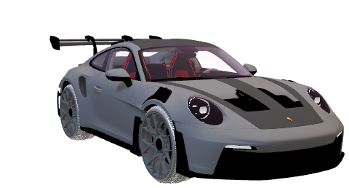
INTRODUCTION
The Linux operating system is a type of computer operating system that is free and open-source, distributed under the GNU General Public License (GPL) which allows users to download, install, and modify the operating system's source code for free.
HISTORY
?
This operating system is built based on the Linux kernel (the core of the operating system), which was first released in 1991 by Linus Torvalds, a student from the University of Helsinki, Finland. Initially, Linux was only developed as a hobby and was not intended for widespread use. However, with the growth of the internet, the Linux developer community expanded, and Linux became increasingly popular.
Is
LINUX
LINUX
Really an Operation System?

Slide 7
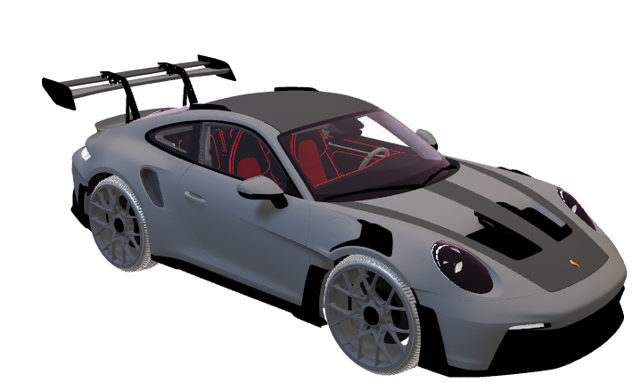
INTRODUCTION
The Linux operating system is a type of computer operating system that is free and open-source, distributed under the GNU General Public License (GPL) which allows users to download, install, and modify the operating system's source code for free.
?
Is
LINUX
LINUX
Really an Operation System?
HISTORY
OPERATING SYSTEM
This operating system is built based on the Linux kernel (the core of the operating system), which was first released in 1991 by Linus Torvalds, a student from the University of Helsinki, Finland. Initially, Linux was only developed as a hobby and was not intended for widespread use. However, with the growth of the internet, the Linux developer community expanded, and Linux became increasingly popular.

Slide 8
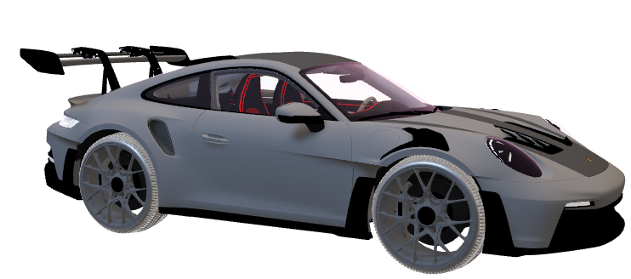
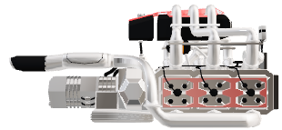
INTRODUCTION
The Linux operating system is a type of computer operating system that is free and open-source, distributed under the GNU General Public License (GPL) which allows users to download, install, and modify the operating system's source code for free.
OPERATING SYSTEM
HISTORY
This operating system is built based on the Linux kernel (the core of the operating system), which was first released in 1991 by Linus Torvalds, a student from the University of Helsinki, Finland. Initially, Linux was only developed as a hobby and was not intended for widespread use. However, with the growth of the internet, the Linux developer community expanded, and Linux became increasingly popular.

Slide 9
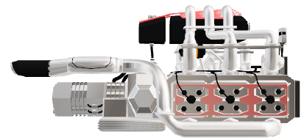
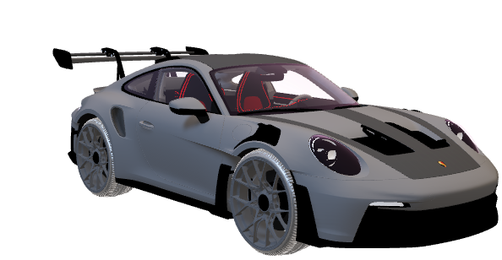
OPERATING SYSTEM
KERNELS

Slide 10
Linux Component
Bootloader
Init System
Graphics Server
Applications
OPERATING SYSTEM
KERNELS
Kernel
Daemon
Desktop Environment

Slide 11
Linux Component
Init System
Graphics Server
Applications
Bootloader
The bootloader on Linux is software, which manages the computer boot process. Although for most users it will only appear as a brief splash screen, the bootloader plays an important role in starting the operating system.
Kernel
Daemon
Desktop Environment

Slide 12
Init System
Graphics Server
Applications
Bootloader
The bootloader on Linux is software, which manages the computer boot process. Although for most users it will only appear as a brief splash screen, the bootloader plays an important role in starting the operating system.
Linux Component
The kernel is one of the main components of the Linux operating system. In fact, the entire system is called Linux, but the kernel is the core that manages the CPU, memory and peripheral devices. The kernel is at the lowest level of the operating system hierarchy.
Kernel
Daemon
Desktop Environment

Slide 13
Bootloader
The bootloader on Linux is software, which manages the computer boot process. Although for most users it will only appear as a brief splash screen, the bootloader plays an important role in starting the operating system.
Linux Component
Graphics Server
Applications
Init System
Init system adalah sub-sistem, yang mem-bootstrap ruang pengguna dan mengontrol daemon. Salah satu sistem init yang banyak digunakan adalah systemd. Sistem ini mengelola proses boot setelah bootloader menyelesaikan tugasnya.
The kernel is one of the main components of the Linux operating system. In fact, the entire system is called Linux, but the kernel is the core that manages the CPU, memory and peripheral devices. The kernel is at the lowest level of the operating system hierarchy.
Daemon
Desktop Environment
Kernel

Slide 14
Graphics Server
Applications
Bootloader
Init System
The bootloader on Linux is software, which manages the computer boot process. Although for most users it will only appear as a brief splash screen, the bootloader plays an important role in starting the operating system.
Init system adalah sub-sistem, yang mem-bootstrap ruang pengguna dan mengontrol daemon. Salah satu sistem init yang banyak digunakan adalah systemd. Sistem ini mengelola proses boot setelah bootloader menyelesaikan tugasnya.
Linux Component
Daemons are background services (such as printing, sound, scheduling, etc.) that start running at boot time, or after logging into the desktop. They work without direct interaction from the user.
Daemon
Desktop Environment
The kernel is one of the main components of the Linux operating system. In fact, the entire system is called Linux, but the kernel is the core that manages the CPU, memory and peripheral devices. The kernel is at the lowest level of the operating system hierarchy.
Kernel

Slide 15
Init System
Init system adalah sub-sistem, yang mem-bootstrap ruang pengguna dan mengontrol daemon. Salah satu sistem init yang banyak digunakan adalah systemd. Sistem ini mengelola proses boot setelah bootloader menyelesaikan tugasnya.
Bootloader
The bootloader on Linux is software, which manages the computer boot process. Although for most users it will only appear as a brief splash screen, the bootloader plays an important role in starting the operating system.
Linux Component
Applications
Graphics Server
A graphics server is a sub-system that displays graphics on a monitor. Also known as X or X server, it is responsible for the display of the user's graphical interface.
Desktop Environment
The kernel is one of the main components of the Linux operating system. In fact, the entire system is called Linux, but the kernel is the core that manages the CPU, memory and peripheral devices. The kernel is at the lowest level of the operating system hierarchy.
Daemons are background services (such as printing, sound, scheduling, etc.) that start running at boot time, or after logging into the desktop. They work without direct interaction from the user.
Kernel
Daemon

Slide 16
Graphics Server
Init System
A graphics server is a sub-system that displays graphics on a monitor. Also known as X or X server, it is responsible for the display of the user's graphical interface.
Init system adalah sub-sistem, yang mem-bootstrap ruang pengguna dan mengontrol daemon. Salah satu sistem init yang banyak digunakan adalah systemd. Sistem ini mengelola proses boot setelah bootloader menyelesaikan tugasnya.
Applications
Linux Component
The desktop environment is the part that actually interacts with the user. There are various Desktop environments to choose from, such as GNOME, Cinnamon, Mate, Pantheon, Enlightenment, KDE, Xfce, and others. Each Desktop environment includes built-in applications such as file managers, configuration tools, web browsers, and games.
Desktop Environment
The kernel is one of the main components of the Linux operating system. In fact, the entire system is called Linux, but the kernel is the core that manages the CPU, memory and peripheral devices. The kernel is at the lowest level of the operating system hierarchy.
Daemons are background services (such as printing, sound, scheduling, etc.) that start running at boot time, or after logging into the desktop. They work without direct interaction from the user.
Kernel
Daemon

Slide 17
Graphics Server
Init System
A graphics server is a sub-system that displays graphics on a monitor. Also known as X or X server, it is responsible for the display of the user's graphical interface.
Init system adalah sub-sistem, yang mem-bootstrap ruang pengguna dan mengontrol daemon. Salah satu sistem init yang banyak digunakan adalah systemd. Sistem ini mengelola proses boot setelah bootloader menyelesaikan tugasnya.
Linux Component
Applications
Desktop environments do not provide a complete suite of applications. Similar to Windows and macOS, Linux provides thousands of high-quality software titles that can be easily found and installed. Modern Linux distributions often include tools such as the App Store, which centralize and simplify the application installation process.
The desktop environment is the part that actually interacts with the user. There are various Desktop environments to choose from, such as GNOME, Cinnamon, Mate, Pantheon, Enlightenment, KDE, Xfce, and others. Each Desktop environment includes built-in applications such as file managers, configuration tools, web browsers, and games.
The kernel is one of the main components of the Linux operating system. In fact, the entire system is called Linux, but the kernel is the core that manages the CPU, memory and peripheral devices. The kernel is at the lowest level of the operating system hierarchy.
Daemons are background services (such as printing, sound, scheduling, etc.) that start running at boot time, or after logging into the desktop. They work without direct interaction from the user.
Kernel
Daemon
Desktop Environment

Slide 18
VOCABULARY
What is responsible for managing hardware resources and providing essential services for the operating system?
A. Mother Board
B. Kernel
C. Windows
OPERATING SYSTEM
KERNELS

Slide 19
VOCABULARY
B. Kernel
OPERATING SYSTEM
KERNELS

Slide 20
VOCABULARY
Ubuntu, Fedora, Debian, and Mint are various kinds of?
A. Windows Version
B. Mac Service
C. Linux Distro

Slide 21
VOCABULARY
C. Linux Distro

Slide 22
VOCABULARY
Which component of a computer system acts as a bridge between software applications and the computer hardware?
A. Operating Software
B. Malware
C. Linux

Slide 23
VOCABULARY
A. Operating Software

Slide 24
Writing Process in Business Communication

